Slide 1
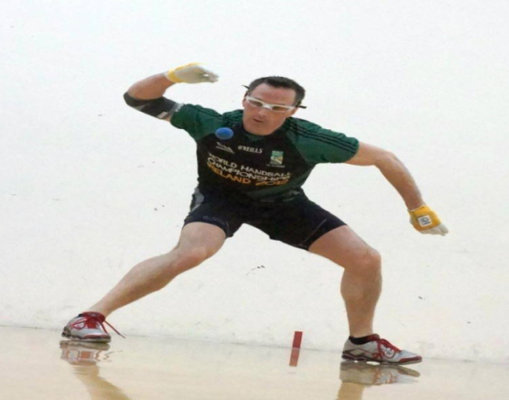
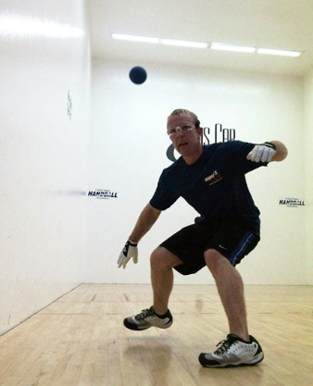
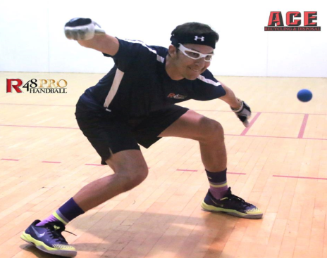
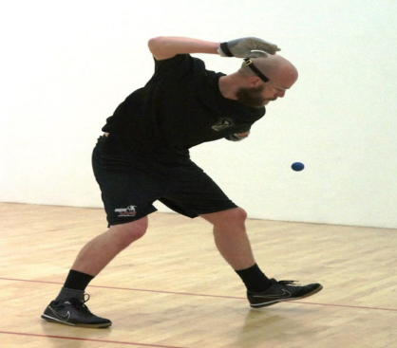
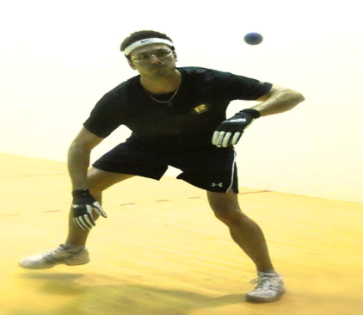
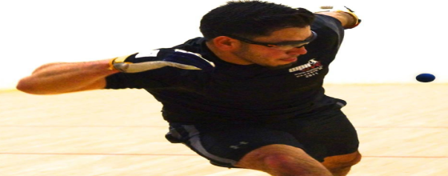
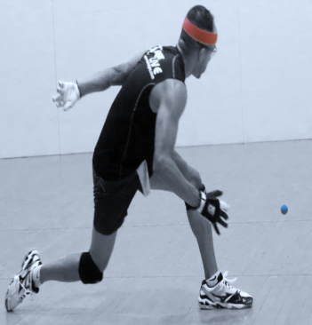
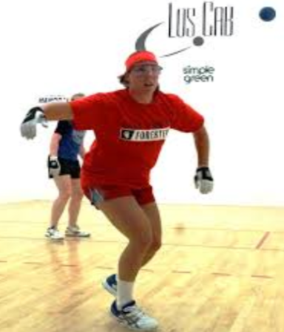
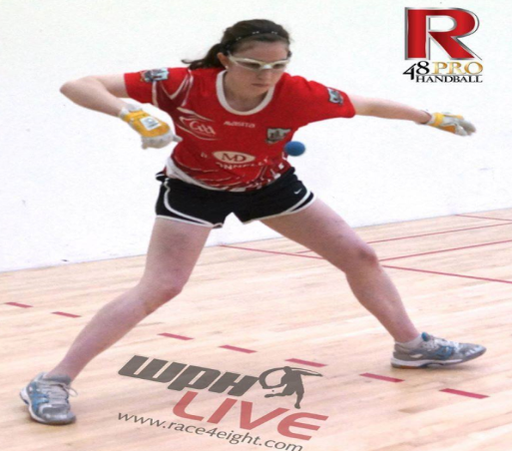
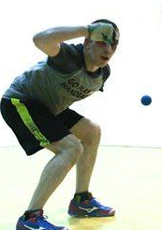
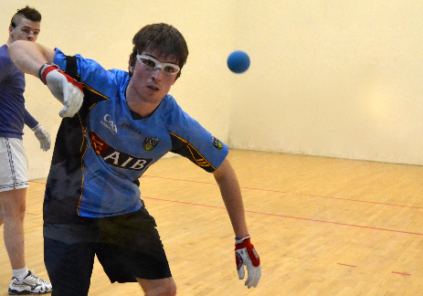
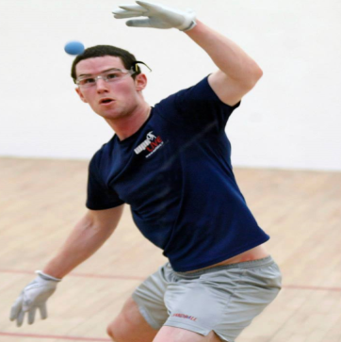
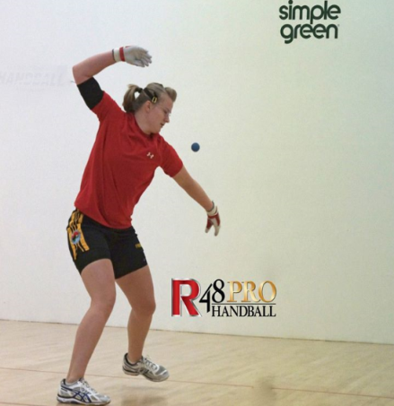
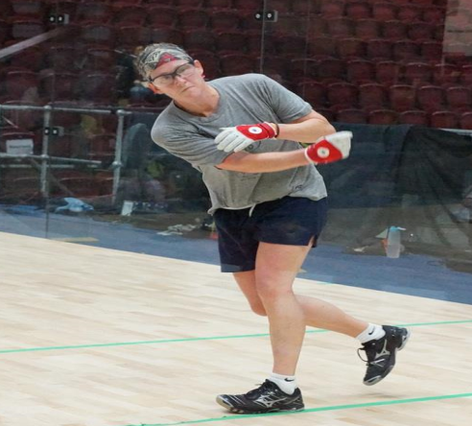
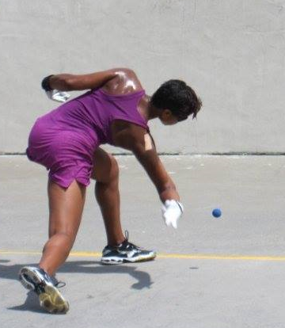
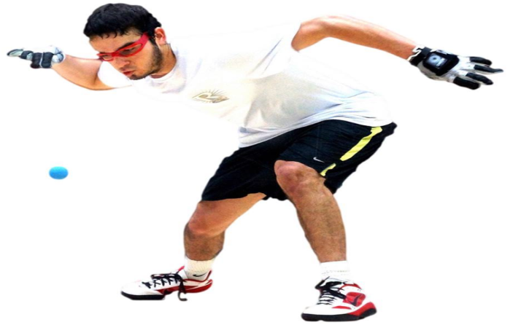
WPH RACE4EIGHT PLAYER STATS 2013/2014

Slide 2
Paul Brady

Slide 3
Luis Moreno
Paul Brady
2013/2014 | Race4eight players stats | Denver 2014
Paul Brady | Vs. | Luis Moreno
432 | Total shots | 431
103 | Total serves | 110
87 | 1st serve in | 78
16% | 1st serve short | 18%
84% | 1st serve % | 70%
2% | Ace serves | 7%
51% | 1st serve points won | 50%
43% | 1st serve points lost | 42%
50% | 2nd serve points won | 25%
27% | 2nd serve points lost | 55%
8%(35 kill shots) | Kill shots | 5% (22 kill shots)
3%(11 pass shots) | Pass shots | 3% (14 pass shots)
25 | Unforced errors | 14
29 | Rallies of 5+ shots won | 17
16.49 minutes | Stalls | 18.05 minutes
1 | Head to Head | 0

Slide 4
Armondo Ortiz
Paul Brady
2013/2014 | Race4eight players stats | NYAC 2014
Paul Brady | Vs. | Armondo Ortiz
231 | Total shots | 244
86 | Total serves | 78
60 | 1st serve in | 52
13% | 1st serve short | 17%
70% | 1st serve % | 67%
2% | Ace serves | 3%
55% | 1st serve points won | 48%
37% | 1st serve points lost | 46%
45% | 2nd serve points won | 30%
27% | 2nd serve points lost | 23%
8% (19 kill shots) | Kill shots | 11% (28 kill shots)
4% (9 pass shots) | Pass shots | 3% (7 pass shots)
13 | Unforced errors | 25
19 | Rallies of 5+ shots won | 3
3.05 minutes | Stalls | 12.47 minutes
1 | Head to Head | 1

Slide 5
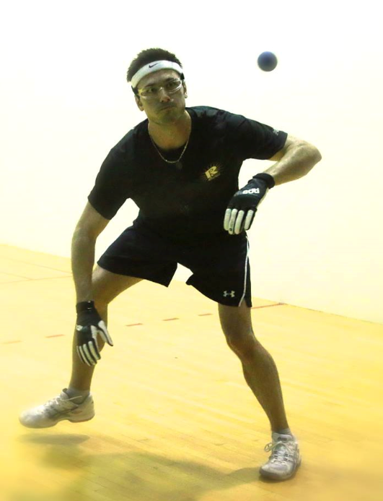
Emmett Peixoto
Paul Brady
2013/2014 | Race4eight players stats | Denver 2014
Paul Brady | Vs. | Emmett Peixoto
343 | Total shots | 346
99 | Total serves | 87
50 | 1st serve in | 48
27% | 1st serve short | 22%
56% | 1st serve % | 55%
4 | Ace serves | 0
66% | 1st serve points won | 44%
30% | 1st serve points lost | 39%
33% | 2nd serve points won | 21%
40% | 2nd serve points lost | 26%
10% (34 kill shots) | Kill shots | 6% (21 kill shots)
1% (2 pass shots) | Pass shots | 1% (4 pass shots)
21 | Unforced errors | 20
22 | Rallies of 5+ shots won | 18
2.45 minutes | Stalls | 7.20 minutes
2 | Head to Head | 0

Slide 6
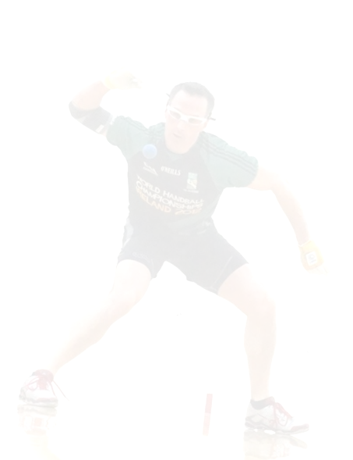
Head to Head |  |  |  | Last Meeting
Paul Brady Wins-Losses 8-1 | 1 | 0 | Luis Moreno | Brady (Denver) 20-21, 21-16, 11-9
 | 1 | 1 | Armondo Ortiz | Ortiz (SLC) 15-21, 21-12,11-5
 | 1 | 0 | Emmett Peixoto | Brady(Denver) 21-13, 21-13
 | 0 | 0 | David Fink | No game this season
 | 1 | 0 | Robbie McCarthy | Brady (NYAC) 21-6, 17-21, 11-6
 | 0 | 0 | Naty Alvarado | No game this season
 | 1 | 0 | Sean Lenning | Brady (Denver) 25-7
 | 0 | 0 | Allan Garner | No game this season
 | 0 | 0 | Diarmaid Nash | No game this season

Slide 7
Luis Moreno

Slide 8
Paul Brady
Luis Moreno
2013/2014 | Race4eight players stats | Denver 2014
Luis Moreno | Vs. | Paul Brady
431 | Total shots | 432
110 | Total serves | 103
78 | 1st serve in | 87
18% | 1st serve short | 16%
70% | 1st serve % | 84%
7% | Ace serves | 2%
50% | 1st serve points won | 51%
42% | 1st serve points lost | 43%
25% | 2nd serve points won | 50%
55% | 2nd serve points lost | 27%
5% (22 kill shots) | Kill shots | 8% (35 kill shots)
3% (14 pass shots) | Pass shots | 3% (11 pass shots)
14 | Unforced errors | 25
29 | Rallies of 5+ shots won | 17
18.05 minutes | Stalls | 16.49 minutes
1 | Head to Head | 0

Slide 9
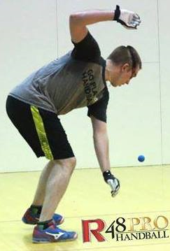
Robbie McCarthy
Luis Moreno
2013/2014 | Race4eight players stats | SLC 2014
Luis Moreno | Vs. | Robbie McCarthy
441 | Total shots | 453
129 | Total serves | 112
53 | 1st serve in | 69
29% | 1st serve short | 15%
41% | 1st serve % | 62%
7% | Ace serves | 6%
51% | 1st serve points won | 54%
41% | 1st serve points lost | 41%
43% | 2nd serve points won | 50%
49% | 2nd serve points lost | 25%
7% (30 kill shots) | Kill shots | 7%(32 kill shots)
2% (10 pass shots) | Pass shots | 4% (17 pass shots)
13 | Unforced errors | 16
19 | Rallies of 5+ shots won | 17
11.33 minutes | Stalls | 3.14 minutes
0 | Head to Head | 2

Slide 10
Allan Garner
Luis Moreno
2013/2014 | Race4eight players stats | Plummer 2013
Luis Moreno | Vs. | Allan Garner
241 | Total shots | 262
92 | Total serves | 101
47 | 1st serve in | 47
22% | 1st serve short | 21%
51% | 1st serve % | 47%
8% | Ace serves | 1%
68% | 1st serve points won | 72%
30% | 1st serve points lost | 32%
40% | 2nd serve points won | 52%
45% | 2nd serve points lost | 23%
8% (19 kill shots) | Kill shots | 11% (29 kill shots)
4%(9 pass shots) | Pass shots | 2% (6 pass shots)
17 | Unforced errors | 21
7 | Rallies of 5+ shots won | 6
1.43 minutes | Stalls | 7.11 minutes
1 | Head to Head | 1

Slide 11
Head to Head |  |  |  | Last Meeting
Luis Moreno Wins-Losses 17-4 | 1 | 0 | Paul Brady | Brady (Denver) 20-21, 21-16, 11-9
 | 0 | 0 | Armondo Ortiz | No game this season
 | 1 | 0 | Emmett Peixoto | Moreno (Plummer) 25-9
 | 1 | 0 | David Fink | Moreno ( Houston) 21-19,21-12
 | 0 | 2 | Robbie McCarthy | McCarthy (SLC) 16-21,21-17, 11-5
 | 3 | 0 | Naty Alvarado | Moreno (SLC) 21-2, 21-4
 | 1 | 0 | Sean Lenning | Moreno (SLC) 21-10, 21-3
 | 1 | 1 | Allan Garner | Moreno (US Open) 15-21, 21-16, 11-9
 | 2 | 0 | Diarmaid Nash | Moreno (Houston) 21-12, 21-15

Slide 12
Armondo Ortiz

Slide 13
Paul Brady
Armondo Ortiz
2013/2014 | Race4eight players stats | NYAC 2014
Armondo Ortiz | Vs. | Paul Brady
244 | Total shots | 231
78 | Total serves | 86
52 | 1st serve in | 60
17% | 1st serve short | 13%
67% | 1st serve % | 70%
3% | Ace serves | 2%
48% | 1st serve points won | 55%
46% | 1st serve points lost | 37%
30% | 2nd serve points won | 45%
23% | 2nd serve points lost | 27%
11% (28 kill shots) | Kill shots | 8% (19 kill shots)
3% (7 pass shots) | Pass shots | 4% (9 pass shots)
25 | Unforced errors | 13
3 | Rallies of 5+ shots won | 19
12.47 minutes | Stalls | 3.05 minutes
1 | Head to Head | 1

Slide 14
Robbie McCarthy
Armondo Ortiz
2013/2014 | Race4eight players stats | Salt Lake City 2014
Armondo Ortiz | Vs. | Robbie McCarthy
254 | Total shots | 236
56 | Total serves | 86
28 | 1st serve in | 50
27% | 1st serve short | 27%
50% | 1st serve % | 58%
2% | Ace serves | 9%
71% | 1st serve points won | 72%
29% | 1st serve points lost | 26%
50% | 2nd serve points won | 33%
21% | 2nd serve points lost | 33%
9%(22 kill shots) | Kill shots | 8% (20 kill shots)
2%(4 pass shots) | Pass shots | 3% (8 pass shots)
21 | Unforced errors | 12
17 | Rallies of 5+ shots won | 14
6.30 minutes | Stalls | 4.03 minutes
0 | Head to Head | 1

Slide 15
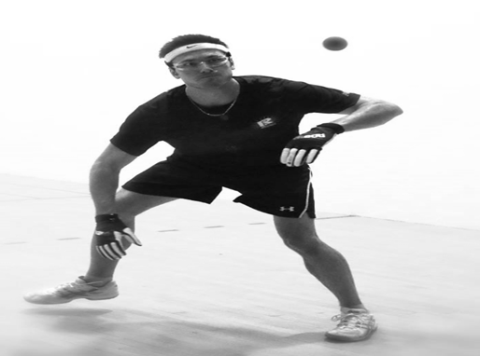
Emmett Peixoto
Armondo Ortiz
2013/2014 | Race4eight players stats | Plummer 2013
Armondo Ortiz | Vs. | Emmett Peixoto
246 | Total shots | 233
86 | Total serves | 63
60 | 1st serve in | 48
9% | 1st serve short | 14%
70% | 1st serve % | 76%
10% | Ace serves | 2%
60% | 1st serve points won | 33%
37% | 1st serve points lost | 48%
60% | 2nd serve points won | 44%
30% | 2nd serve points lost | 44%
14% (34 kill shots) | Kill shots | 9% (20 kill shots)
4% (11 pass shots) | Pass shots | 3% (8 pass shots)
17 | Unforced errors | 5
13 | Rallies of 5+ shots won | 8
5.08 minutes | Stalls | 2.45 minutes
1 | Head to Head | 1

Slide 16
Head to Head |  |  |  | Last Meeting
Armondo Ortiz Wins-Losses 8-4 | 0 | 0 | Luis Moreno | No game this season
 | 1 | 1 | Paul Brady | Ortiz (SLC) 15-21, 21-12,11-5
 | 1 | 1 | Emmett Peixoto | Peixoto (Denver) 25-5
 | 2 | 0 | David Fink | Ortiz (NYAC) 25-12
 | 0 | 1 | Robbie McCarthy | McCarthy (SLC) 21-6, 21-19
 | 1 | 0 | Naty Alvarado | Ortiz (plummer) 25-23
 | 1 | 0 | Sean Lenning | Ortiz (Denver) 25-14
 | 0 | 1 | Allan Garner | Garner (plummer) 21-5, 21-10
 | 0 | 0 | Diarmaid Nash | No game this season

Slide 17
Emmett Peixoto

Slide 18
Armondo Ortiz
Emmett Peixoto
2013/2014 | Race4eight players stats | Plummer 2013
Emmett Peixoto | Vs. | Armondo Ortiz
233 | Total shots | 246
63 | Total serves | 86
48 | 1st serve in | 60
14% | 1st serve short | 9%
76% | 1st serve % | 70%
2% | Ace serves | 10%
33% | 1st serve points won | 60%
48% | 1st serve points lost | 37%
44% | 2nd serve points won | 60%
44% | 2nd serve points lost | 30%
9% (20 kill shots) | Kill shots | 14% (34 kill shots)
3% (8 pass shots) | Pass shots | 4% (11 pass shots)
5 | Unforced errors | 17
8 | Rallies of 5+ shots won | 13
2.45 minutes | Stalls | 5.08 minutes
1 | Head to Head | 1

Slide 19
Paul Brady
Emmett Peixoto
2013/2014 | Race4eight players stats | Denver 2014
Emmett Peixoto | Vs. | Paul Brady
346 | Total shots | 343
87 | Total serves | 99
48 | 1st serve in | 50
22% | 1st serve short | 27%
55% | 1st serve % | 56%
0 | Ace serves | 4
44% | 1st serve points won | 66%
39% | 1st serve points lost | 30%
21% | 2nd serve points won | 33%
26% | 2nd serve points lost | 40%
6% (21 kill shots) | Kill shots | 10%(34 kill shots)
1% (4 pass shots) | Pass shots | 1% (2 pass shots)
20 | Unforced errors | 21
18 | Rallies of 5+ shots won | 22
7.20 minutes | Stalls | 2.45 minutes
0 | Head to Head | 2

Slide 20
Robbie McCarthy
Emmett Peixoto
2013/2014 | Race4eight players stats | SLC 2014
Emmett Peixoto | Vs. | Robbie McCarthy
494 | Total shots | 492
74 | Total serves | 93
51 | 1st serve in | 62
15% | 1st serve short | 15%
69% | 1st serve % | 66%
0% | Ace serves | 6%
53% | 1st serve points won | 58%
43% | 1st serve points lost | 29%
45% | 2nd serve points won | 57%
36% | 2nd serve points lost | 21%
4% (22 kill shots) | Kill shots | 6%(29 kill shots)
1% (5 pass shots) | Pass shots | 2%( 9 pass shots)
23 | Unforced errors | 18
27 | Rallies of 5+ shots won | 27
19.51 minutes | Stalls | 5.43 minutes
0 | Head to Head | 1

Slide 21
Head to Head |  |  |  | Last Meeting
Emmett Peixoto Wins-Losses 10-7 | 0 | 1 | Luis Moreno | Moreno (Plummer) 25-9
 | 1 | 1 | Armondo Ortiz | Peixoto (Denver) 25-5
 | 0 | 2 | Paul Brady | Brady (Denver) 21-13, 21-13
 | 1 | 0 | David Fink | Peixoto (NYAC) 25-23
 | 0 | 1 | Robbie McCarthy | McCarthy (SLC) 21-20, 21-11
 | 0 | 0 | Naty Alvarado | No game this season
 | 1 | 1 | Sean Lenning | Lenning (SLC) 25-14
 | 0 | 0 | Allan Garner | No game this season
 | 0 | 1 | Diarmaid Nash | Nash ( Houston) 13-25, 25-11, 11-9

Slide 22
David Fink

Slide 23
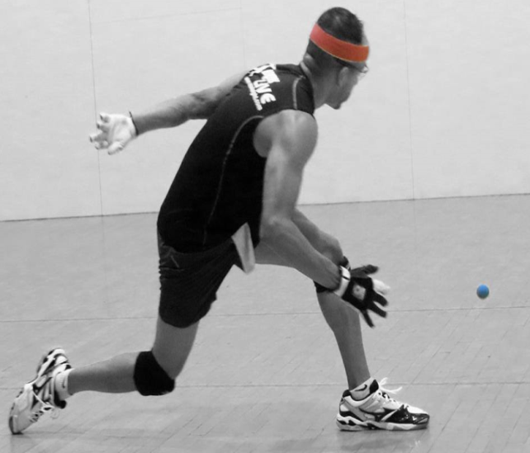
Naty Alvarado
David Fink
2013/2014 | Race4eight players stats | US Open 2013
David Fink | Vs. | Naty Alvarado
322 | Total shots | 320
102 | Total serves | 112
59 | 1st serve in | 67
22% | 1st serve short | 21%
58% | 1st serve % | 60%
5% | Ace serves | 9%
61% | 1st serve points won | 55%
32% | 1st serve points lost | 33%
23% | 2nd serve points won | 39%
59% | 2nd serve points lost | 39%
6% (19 kill shots) | Kill shots | 9% (29 kill shots)
3% (10 pass shots) | Pass shots | 3% (11 pass shots)
8 | Unforced errors | 14
14 | Rallies of 5+ shots won | 11
15.31 minutes | Stalls | 5.17 minutes
0 | Head to Head | 1

Slide 24
Martin Mulkerrins
David Fink
2013/2014 | Race4eight players stats | Houston 2014
David Fink | Vs. | Mairtin Mulkerrins
169 | Total shots | 168
53 | Total serves | 31
31 | 1st serve in | 25
26% | 1st serve short | 19%
58% | 1st serve % | 81%
4% | Ace serves | 6%
52% | 1st serve points won | 40%
28% | 1st serve points lost | 44%
64% | 2nd serve points won | 67%
36% | 2nd serve points lost | 33%
11% (18 kill shots) | Kill shots | 4% (6 kill shots)
2% (3 pass shots) | Pass shots | 1% (1 pass shots)
7 | Unforced errors | 10
14 | Rallies of 5+ shots won | 13
5.16 minutes | Stalls | 1.03 minutes
1 | Head to Head | 0

Slide 25
Luis Moreno
David Fink
2013/2014 | Race4eight players stats | Houston 2014
David Fink | Vs. | Luis Moreno
319 | Total shots | 302
73 | Total serves | 90
48 | 1st serve in | 57
16% | 1st serve short | 19%
66% | 1st serve % | 63%
1% | Ace serves | 6%
50% | 1st serve points won | 51%
33% | 1st serve points lost | 16%
25% | 2nd serve points won | 41%
50% | 2nd serve points lost | 35%
8% (26 kill shots) | Kill shots | 10% (30 kill shots)
2% (5 pass shots) | Pass shots | 4% (11 pass shots)
8 | Unforced errors | 5
10 | Rallies of 5+ shots won | 13
15.07 minutes | Stalls | 0 minutes
0 | Head to Head | 1

Slide 26
Head to Head |  |  |  | Last Meeting
David Fink Wins-Losses 7-7 | 0 | 1 | Luis Moreno | Moreno ( Houston) 21-19,21-12
 | 0 | 2 | Armondo Ortiz | Ortiz (NYAC) 25-12
 | 0 | 1 | Emmett Peixoto | Peixoto (NYAC) 25-23
 | 0 | 0 | Paul Brady | No game this season
 | 1 | 0 | Robbie McCarthy | Fink (Houston) 25-12
 | 0 | 1 | Naty Alvarado | Alvarado (SLC) 16-21, 21-14, 11-7
 | 1 | 1 | Sean Lenning | Lenning (SLC) 25-14
 | 0 | 0 | Allan Garner | No game this season
 | 0 | 0 | Diarmaid Nash | No game this season

Slide 27
Robbie McCarthy

Slide 28
Emmett Peixoto
Robbie McCarthy
2013/2014 | Race4eight players stats | SLC 2014
Robbie McCarthy | Vs. | Emmett Peixoto
492 | Total shots | 494
93 | Total serves | 74
62 | 1st serve in | 51
15% | 1st serve short | 15%
66% | 1st serve % | 69%
6% | Ace serves | 0%
58% | 1st serve points won | 53%
29% | 1st serve points lost | 43%
57% | 2nd serve points won | 45%
21% | 2nd serve points lost | 36%
6%(29 kill shots) | Kill shots | 4% (22 kill shots)
2%( 9 pass shots) | Pass shots | 1% (5 pass shots)
18 | Unforced errors | 23
27 | Rallies of 5+ shots won | 27
5.43 minutes | Stalls | 19.51 minutes
1 | Head to Head | 0

Slide 29
Paul Brady
Robbie McCarthy
2013/2014 | Race4eight players stats | NYAC 2014
Robbie McCarthy | Vs. | Paul Brady
396 | Total shots | 383
85 | Total serves | 94
65 | 1st serve in | 79
21% | 1st serve short | 9%
76% | 1st serve % | 84%
5% | Ace serves | 3%
55% | 1st serve points won | 62%
40% | 1st serve points lost | 32%
16% | 2nd serve points won | 25%
33% | 2nd serve points lost | 63%
7% (27 kill shots) | Kill shots | 11% (42 kill shots)
3% (13 pass shots) | Pass shots | 2% (8 pass shots)
18 | Unforced errors | 10
12 | Rallies of 5+ shots won | 20
1.57 minute | Stalls | 3.23 minutes
0 | Head to Head | 1

Slide 30
Luis Moreno
Robbie McCarthy
2013/2014 | Race4eight players stats | SLC 2014
Robbie McCarthy | Vs. | Luis Moreno
453 | Total shots | 441
112 | Total serves | 129
69 | 1st serve in | 53
15% | 1st serve short | 29%
62% | 1st serve % | 41%
6% | Ace serves | 7%
54% | 1st serve points won | 51%
41% | 1st serve points lost | 41%
50% | 2nd serve points won | 43%
25% | 2nd serve points lost | 49%
7% (32 kill shots) | Kill shots | 7% (30 kill shots)
4% (17 pass shots) | Pass shots | 2% (10 pass shots)
16 | Unforced errors | 13
17 | Rallies of 5+ shots won | 19
3.14 minutes | Stalls | 11.33 minutes
2 | Head to Head | 0

Slide 31
Head to Head |  |  |  | Last Meeting
Robbie McCarthy Wins-Losses 9-2 | 2 | 0 | Luis Moreno | McCarthy (SLC) 16-21,21-17, 11-5
 | 1 | 0 | Armondo Ortiz | McCarthy (SLC) 21-6, 21-19
 | 1 | 0 | Emmett Peixoto | McCarthy (SLC) 21-20, 21-11
 | 0 | 1 | David Fink | Fink (Houston) 25-12
 | 0 | 1 | Paul Brady | Brady (NYAC) 21-6, 17-21, 11-6
 | 1 | 0 | Naty Alvarado | McCarthy(NYAC) 21-3, 21-12
 | 0 | 0 | Sean Lenning | No game this season
 | 0 | 0 | Allan Garner | No game this season
 | 0 | 0 | Diarmaid Nash | No game this season

Slide 32
Naty Alvarado

Slide 33
Luis Moreno
Naty Alvarado
2013/2014 | Race4eight players stats | US Open
Naty Alvarado | Vs. | Luis Moreno
243 | Total shots | 231
74 | Total serves | 88
48 | 1st serve in | 56
23% | 1st serve short | 17%
65% | 1st serve % | 64%
5% | Ace serves | 8%
48% | 1st serve points won | 57%
31% | 1st serve points lost | 33%
41% | 2nd serve points won | 47%
47% | 2nd serve points lost | 33%
9% (21 kill shots) | Kill shots | 8% (19 kill shots)
4% (9 pass shots) | Pass shots | 6% (14 pass shots)
16 | Unforced errors | 7
9 | Rallies of 5+ shots won | 7
19.31 minutes | Stalls | 5.18 minutes
0 | Head to Head | 1

Slide 34
David Fink
Naty Alvarado
2013/2014 | Race4eight players stats | SLC 2014
Naty Alvarado | Vs. | David Fink
320 | Total shots | 322
112 | Total serves | 102
67 | 1st serve in | 59
21% | 1st serve short | 22%
60% | 1st serve % | 58%
9% | Ace serves | 5%
55% | 1st serve points won | 61%
33% | 1st serve points lost | 32%
39% | 2nd serve points won | 23%
39% | 2nd serve points lost | 59%
9% (29 kill shots) | Kill shots | 6% (19 kill shots)
3% (11 pass shots) | Pass shots | 3% (10 pass shots)
14 | Unforced errors | 8
11 | Rallies of 5+ shots won | 14
5.17 minutes | Stalls | 15.31 minutes
1 | Head to Head | 0

Slide 35
Sean Lenning
Naty Alvarado
2013/2014 | Race4eight players stats | US Open 2013
Naty Alvarado | Vs. | Sean Lenning
229 | Total shots | 229
98 | Total serves | 98
66 | 1st serve in | 48
15% | 1st serve short | 26%
67% | 1st serve % | 49%
13% | Ace serves | 2%
52% | 1st serve points won | 40%
35% | 1st serve points lost | 33%
53% | 2nd serve points won | 36%
27% | 2nd serve points lost | 44%
(23 kill shots) | Kill shots | (13 kill shots)
(10 pass shots) | Pass shots | (10 pass shots)
16 | Unforced errors | 14
14 | Rallies of 5+ shots won | 15
11.18 Minutes | Stalls | 5.39 Minutes
1 | Head to Head | 0

Slide 36
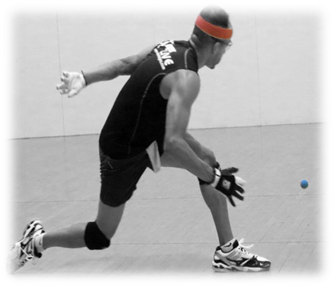
Head to Head |  |  |  | Last Meeting
Naty Alvarado Wins-Losses 11-6 | 0 | 3 | Luis Moreno | Moreno (SLC) 21-2, 21-4
 | 0 | 1 | Armondo Ortiz | Ortiz (plummer) 25-23
 | 0 | 0 | Emmett Peixoto | No game this season
 | 1 | 0 | David Fink | Alvarado (SLC) 16-21, 21-14, 11-7
 | 0 | 1 | Robbie McCarthy | McCarthy(NYAC) 21-3, 21-12
 | 0 | 0 | Paul Brady | No game this season
 | 0 | 1 | Sean Lenning | Alvarado (US Open) 21-11, 21-18
 | 0 | 0 | Allan Garner | No game this season
 | 0 | 0 | Diarmaid Nash | No game this season

Slide 37
Sean Lenning

Slide 38
Luis Moreno
Sean Lenning
2013/2014 | Race4eight players stats | Salt Lake City 2014
Sean Lenning | Vs. | Luis Moreno
136 | Total shots | 119
34 | Total serves | 60
25 | 1st serve in | 38
12% | 1st serve short | 27%
85% | 1st serve % | 65%
3% | Ace serves | 18%
32% | 1st serve points won | 48%
29% | 1st serve points lost | 10%
50% | 2nd serve points won | 50%
50% | 2nd serve points lost | 31%
8% (11 kill shots) | Kill shots | 16%(19 kill shots)
2%(3 pass shots) | Pass shots | 3%(4 pass shots)
13 | Unforced errors | 6
9 | Rallies of 5+ shots won | 16
4.17 minutes | Stalls | No time outs taken
0 | Head to Head | 1

Slide 39
Naty Alvarado
Sean Lenning
2013/2014 | Race4eight players stats | US Open 2013
Sean Lenning | Vs. | Naty Alvarado
229 | Total shots | 229
98 | Total serves | 98
48 | 1st serve in | 66
26% | 1st serve short | 15%
49% | 1st serve % | 67%
2% | Ace serves | 13%
40% | 1st serve points won | 52%
33% | 1st serve points lost | 35%
36% | 2nd serve points won | 53%
44% | 2nd serve points lost | 27%
(13 kill shots) | Kill shots | 10% (23 kill shots)
(10 pass shots) | Pass shots | 4%(10 pass shots)
14 | Unforced errors | 16
15 | Rallies of 5+ shots won | 14
5.39 Minutes | Stalls | 11.18 Minutes
0 | Head to Head | 1

Slide 40
Head to Head |  |  |  | Last Meeting
Sean Lenning Wins-Losses 6-10 | 0 | 1 | Luis Moreno | Moreno (SLC) 21-10, 21-3
 | 0 | 1 | Armondo Ortiz | Ortiz (Denver) 25-14
 | 1 | 1 | Emmett Peixoto | Lenning (SLC) 25-14
 | 1 | 1 | David Fink | Lenning (SLC) 25-14
 | 0 | 0 | Robbie McCarthy | No game this season
 | 1 | 0 | Naty Alvarado | Alvarado (US Open) 21-11, 21-18
 | 1 | 0 | Paul Brady | Brady (Denver) 25-7
 | 0 | 1 | Allan Garner | Garner (US Open) 21-3,21-2
 | 0 | 0 | Diarmaid Nash | No game this season

Slide 41
Allan Garner

Slide 42
Armondo Ortiz
Allan Garner
2013/2014 | Race4eight players stats | Plummer 2013
Allan Garner | Vs. | Armondo Ortiz
149 | Total shots | 160
83 | Total serves | 52
41 | 1st serve in | 22
25% | 1st serve short | 21%
49% | 1st serve % | 42%
4% | Ace serves | 8%
71% | 1st serve points won | 21%
18% | 1st serve points lost | 28%
43% | 2nd serve points won | 36%
24% | 2nd serve points lost | 55%
12% (18 kill shots) | Kill shots | 13% (20 kill shots)
7% (11 pass shots) | Pass shots | 3% (4 pass shots)
10 | Unforced errors | 16
16 | Rallies of 5+ shots won | 5
4.32 minutes | Stalls | 3.25 minutes
1 | Head to Head | 0

Slide 43
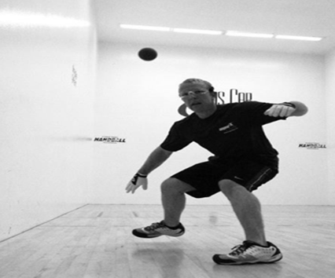
Luis Moreno
Allan Garner
2013/2014 | Race4eight players stats | US Open 2013
Allan Garner | Vs. | Luis Moreno
303 | Total shots | 293
127 | Total serves | 112
57 | 1st serve in | 58
24% | 1st serve short | 18%
45% | 1st serve % | 52%
7% | Ace serves | 4%
49% | 1st serve points won | 58%
37% | 1st serve points lost | 41%
58% | 2nd serve points won | 55%
29% | 2nd serve points lost | 25%
10% (30 kill shots) | Kill shots | 9% (27 kill shots)
3% (8 pass shots) | Pass shots | 3% (10 pass shots)
11 | Unforced errors | 13
12 | Rallies of 5+ shots won | 19
11.25 minutes | Stalls | 9.27 minutes
1 | Head to Head | 1

Slide 44
Luis Moreno
Allan Garner
2013/2014 | Race4eight players stats | Plummer 2013
Allan Garner | Vs. | Luis Moreno
262 | Total shots | 241
101 | Total serves | 92
47 | 1st serve in | 47
21% | 1st serve short | 22%
47% | 1st serve % | 51%
1% | Ace serves | 8%
72% | 1st serve points won | 68%
32% | 1st serve points lost | 30%
52% | 2nd serve points won | 40%
23% | 2nd serve points lost | 45%
11% (29 kill shots) | Kill shots | 8% (19 kill shots)
2% (6 pass shots) | Pass shots | 4%(9 pass shots)
21 | Unforced errors | 17
6 | Rallies of 5+ shots won | 7
7.11 minutes | Stalls | 1.43 minutes
1 | Head to Head | 1

Slide 45
Head to Head |  |  |  | Last Meeting
Allan Garner Wins-Losses 7-2 | 1 | 1 | Luis Moreno | Moreno (US Open) 15-21, 21-16, 11-9
 | 1 | 0 | Armondo Ortiz | Garner (plummer) 21-5, 21-10
 | 0 | 0 | Emmett Peixoto | No game this season
 | 0 | 0 | David Fink | No game this season
 | 0 | 0 | Robbie McCarthy | No game this season
 | 0 | 0 | Naty Alvarado | No game this season
 | 1 | 0 | Sean Lenning | Garner (US Open) 21-3,21-2
 | 0 | 0 | Paul Brady | No game this season
 | 0 | 1 | Diarmaid Nash | Nash (Houston) 25-5

Slide 46
Diarmaid Nash

Slide 47
Luis Moreno
Diarmaid Nash
2013/2014 | Race4eight players stats | Houston 2014
Diarmaid Nash | Vs. | Luis Moreno
275 | Total shots | 267
62 | Total serves | 91
44 | 1st serve in | 63
16% | 1st serve short | 18%
71% | 1st serve % | 69%
5% | Ace serves | 14%
48% | 1st serve points won | 51%
48% | 1st serve points lost | 30%
20% | 2nd serve points won | 44%
50% | 2nd serve points lost | 19%
8% (23 kill shots) | Kill shots | 10% (27 kill shots)
1% (3 pass shots) | Pass shots | 4% (12 pass shots)
11 | Unforced errors | 13
11 | Rallies of 5+ shots won | 14
6.37 minutes | Stalls | 6.26 minutes
0 | Head to Head | 2

Slide 48
Emmett Peixoto
Diarmaid Nash
2013/2014 | Race4eight players stats | Houston 2014
Diarmaid Nash | Vs. | Emmett Peixoto
441 | Total shots | 436
104 | Total serves | 113
68 | 1st serve in | 71
13% | 1st serve short | 16%
61% | 1st serve % | 63%
5% | Ace serves | 4%
56% | 1st serve points won | 55%
41% | 1st serve points lost | 42%
29% | 2nd serve points won | 33%
64% | 2nd serve points lost | 27%
9% (38 kill shots) | Kill shots | 8% (34 kill shots)
1% (6 pass shots) | Pass shots | 3% (13 pass shots)
16 | Unforced errors | 15
30 | Rallies of 5+ shots won | 32
5.25 minutes | Stalls | 20.18 minutes
1 | Head to Head | 0

Slide 49
Head to Head |  |  |  | Last Meeting
Diarmaid Nash Wins-Losses 4-3 | 0 | 2 | Luis Moreno | Moreno (Houston) 21-12, 21-15
 | 0 | 0 | Armondo Ortiz | No game this season
 | 1 | 0 | Emmett Peixoto | Nash ( Houston) 13-25, 25-11, 11-9
 | 0 | 0 | David Fink | No game this season
 | 0 | 0 | Robbie McCarthy | No game this season
 | 0 | 0 | Naty Alvarado | No game this season
 | 0 | 0 | Sean Lenning | No game this season
 | 1 | 0 | Allan Garner | Nash (Houston) 25-5
 | 0 | 0 | Paul Brady | No game this season

Slide 50
Catriona Casey

Slide 51
Aisling Reilly
Catriona Casey
2013/2014 | Race4eight players stats | SLC 2014
Catriona Casey | Vs. | Aisling Reilly
 | Total shots
69 | Total serves | 43
58 | 1st serve in | 35
7% | 1st serve short | 9%
84% | 1st serve % | 81%
4% | Ace serves | 5%
64% | 1st serve points won | 51%
33% | 1st serve points lost | 43%
60% | 2nd serve points won | 50%
20% | 2nd serve points lost | 25%
6% (15 kill shots) | Kill shots | 6% (18 kill shots)
2% (6 pass shots) | Pass shots | 1% (4 pass shots)
7 | Unforced errors | 22
20 | Rallies of 5+ shots won | 12
1.13 minutes | Stalls | 3.40 minutes
2 | Head to Head | 0

Slide 52
Tracy Davis
Catriona Casey
2013/2014 | Race4eight players stats | NYAC 2014
Catriona Casey | Vs. | Tracey Davis
242 | Total shots | 257
69 | Total serves | 57
60 | 1st serve in | 27
58% | 1st serve short | 28%
87% | 1st serve % | 47%
0% | Ace serves | 7%
63% | 1st serve points won | 37%
28% | 1st serve points lost | 52%
50% | 2nd serve points won | 14%
50% | 2nd serve points lost | 33%
10% (24 kill shots) | Kill shots | 5% (13 kill shots)
1% (2 pass shots) | Pass shots | 2% (5 pass shots)
8 | Unforced errors | 18
17 | Rallies of 5+ shots won | 10
No stall | Stalls | 1.12 minutes
1 | Head to Head | 0

Slide 53
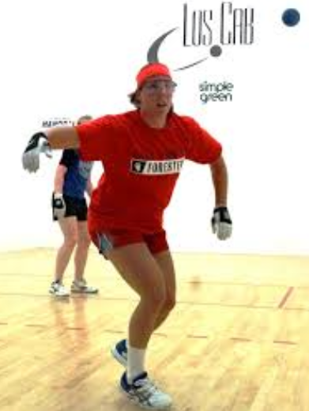
Megan Mehilos
Catriona Casey
2013/2014 | Race4eight players stats | US open 2013
Catriona Casey | Vs. | Megan Mehilos
191 | Total shots | 199
64 | Total serves | 38
51 | 1st serve in | 28
11% | 1st serve short | 8%
80% | 1st serve % | 71%
3% | Ace serves | 0%
73% | 1st serve points won | 64%
24% | 1st serve points lost | 36%
57% | 2nd serve points won | 67%
29% | 2nd serve points lost | 33%
13% (25 kill shots) | Kill shots | 7% (13 kill shots)
5% (9 pass shots) | Pass shots | 1% (2 pass shots)
12 | Unforced errors | 17
12 | Rallies of 5+ shots won | 7
No stalls | Stalls | 4. 17 minutes
1 | Head to Head | 0

Slide 54
Head to Head |  |  |  | Last Meeting
Catriona Casey W-L 10-0 | 2 | 0 | Aisling Reilly | Casey (SLC) 21-14, 21-6
 | 1 | 0 | Tracey Davis | Casey (NYAC) 21-12,21-3

Slide 55
Aisling Reilly

Slide 56
Catriona Casey
Aisling Reilly
2013/2014 | Race4eight players stats | SLC 2014
Aisling Reilly | Vs. | Catriona Casey
277 | Total shots | 256
43 | Total serves | 69
35 | 1st serve in | 58
9% | 1st serve short | 7%
81% | 1st serve % | 84%
5% | Ace serves | 4%
51% | 1st serve points won | 64%
43% | 1st serve points lost | 33%
50% | 2nd serve points won | 60%
25% | 2nd serve points lost | 20%
6% (18 kill shots) | Kill shots | 6% (15 kill shots)
1% (4 pass shots) | Pass shots | 2% (6 pass shots)
22 | Unforced errors | 7
12 | Rallies of 5+ shots won | 20
3.40 minutes | Stalls | 1.13 minutes
0 | Head to Head | 2

Slide 57
Catriona Casey
Aisling Reilly
2013/2014 | Race4eight players stats | US open 2013
Aisling Reilly | Vs. | Catriona Casey
350 | Total shots | 344
85 | Total serves | 97
50 | 1st serve in | 71
20% | 1st serve short | 8%
59% | 1st serve % | 73%
0 | Ace serves | 1%
40% | 1st serve points won | 55%
50% | 1st serve points lost | 34%
35% | 2nd serve points won | 38%
35% | 2nd serve points lost | 38%
6% (20 kill shots) | Kill shots | 10% (33 kill shots)
3%(9 Pass shots) | Pass shots | 3% (12 pass shots)
18 | Unforced errors | 15
19 | Rallies of 5+ shots won | 17
3.35 minutes | Stalls | 3.48 minutes
0 | Head to Head | 2

Slide 58
Head to Head |  |  |  | Last Meeting
Aisling Reilly W-L 3-2 | 0 | 2 | Catriona Casey | Casey (SLC) 21-14, 21-6
 | 2 | 0 | Tracey Davis | Reilly (SLC) 21-10, 21-8

Slide 59
Tracy Davis

Slide 60
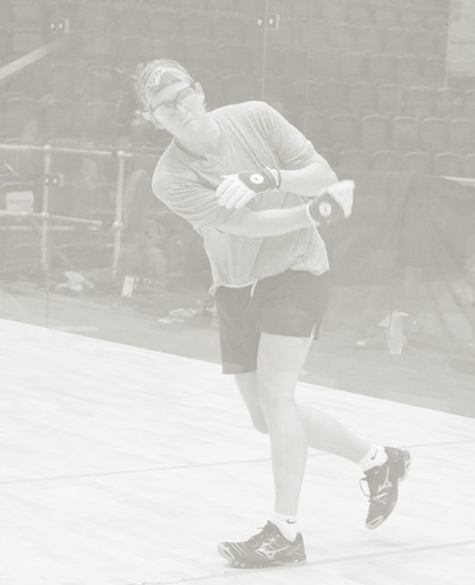
Lisa Fraser Gilmore
Tracy Davis
2013/2014 | Race4eight players stats | NYAC 2014
Tracey Davis | Vs. | Lisa Fraser Gilmore
218 | Total shots | 206
81 | Total serves | 71
50 | 1st serve in | 46
16% | 1st serve short | 18%
62% | 1st serve % | 64%
12% | Ace serves | 0%
68% | 1st serve points won | 57%
32% | 1st serve points lost | 43%
46% | 2nd serve points won | 38%
54% | 2nd serve points lost | 62%
8% (18 kill shots) | Kill shots | 10% (21 kill shots)
3% (6 pass shots) | Pass shots | 1% (3 pass shots)
12 | Unforced errors | 7
15 | Rallies of 5+ shots won | 14
No time outs taken | Stalls | 3 time outs taken/1 minute Injury time
1 | Head to Head | 0

Slide 61
Catriona Casey
Tracy Davis
2013/2014 | Race4eight players stats | NYAC 2014
Tracey Davis | Vs. | Casey
257 | Total shots | 242
57 | Total serves | 69
27 | 1st serve in | 60
28% | 1st serve short | 58%
47% | 1st serve % | 87%
7% | Ace serves | 0%
37% | 1st serve points won | 63%
52% | 1st serve points lost | 28%
14% | 2nd serve points won | 50%
33% | 2nd serve points lost | 50%
5% (13 kill shots) | Kill shots | 10% (24 kill shots)
2% (5 pass shots) | Pass shots | 1% (2 pass shots)
18 | Unforced errors | 8
10 | Rallies of 5+ shots won | 17
1.12 minutes | Stalls | No stall
0 | Head to Head | 1

Slide 62
Head to Head |  |  |  | Last Meeting
Tracy Davis W-L 5-5 | 0 | 1 | Catriona Casey | Casey (SLC) 21-12,21,3
 | 0 | 2 | Aisling Reilly | Reilly (SLC) 21-10.21-8

